Slide 1

OBJECT DETECTION
Sabbiu Shah
Sagar Adhikari
Samip Subedi

Slide 2
Vision
Acquiring
Processing
Understanding

Slide 3
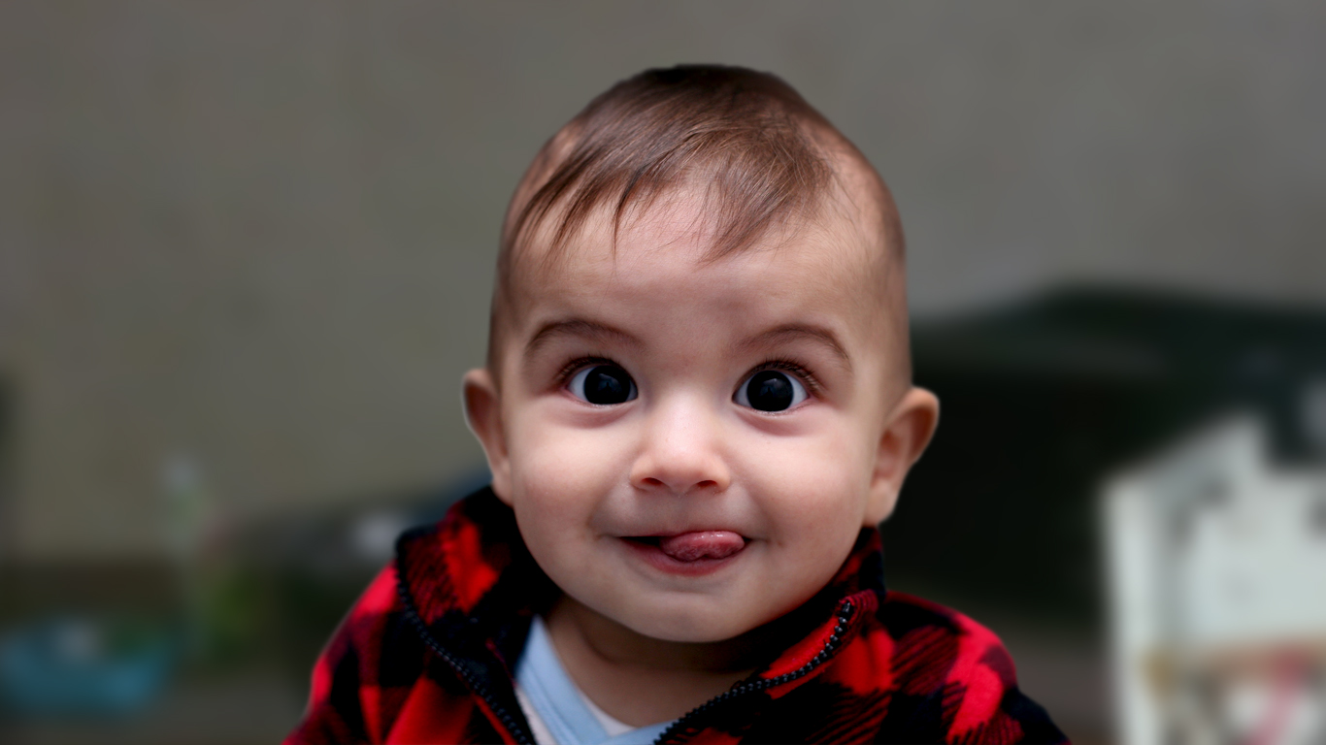
What we see

Slide 4
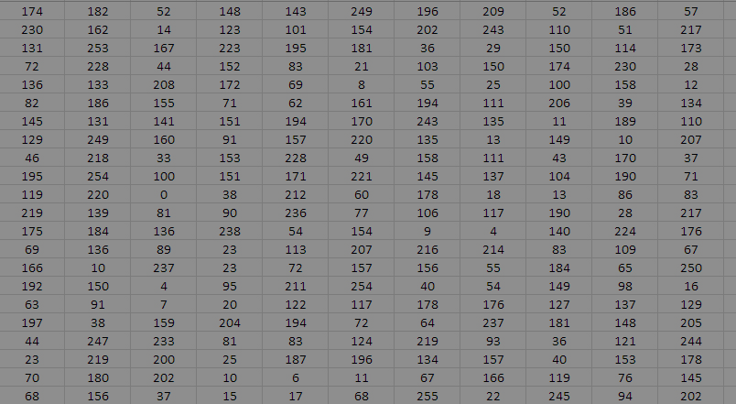
What Computer sees

Slide 5

Computer Vision

Slide 6
Computer Vision
Task that include methods for Acquiring, processing and understanding digital images by Computer.

Slide 7
Computer Vision
Based on Numerical or Symbolic information.

Slide 8
Computer Vision

Slide 9
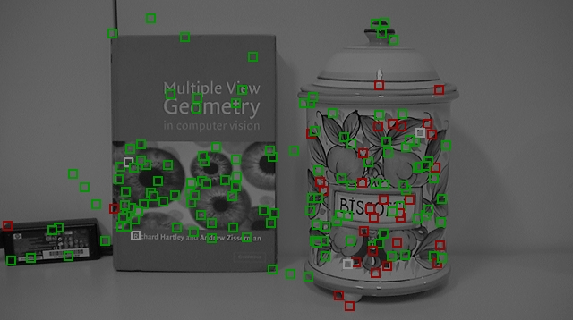
Object Detection

Slide 10
Object Detection
Field of Computer Vision

Slide 11
Object Detection
Focuses on “Where”
rather than “What”

Slide 12

Our Objectives

Slide 13
Objectives

Slide 14
Objectives

Slide 15
Objectives

Slide 16
Methodology
Feature Descriptor (SIFT)
K-means Clustering
Support Vector Machine (SVM) classifier
Localization
Reinforcement Learning

Slide 17
Features Descriptor(SIFT)
Very popular feature Extraction Algorithm proposed by David Lowe in 1999
Invariant to
Scale
Orientation
Ilumination
ViewPoint

Slide 18
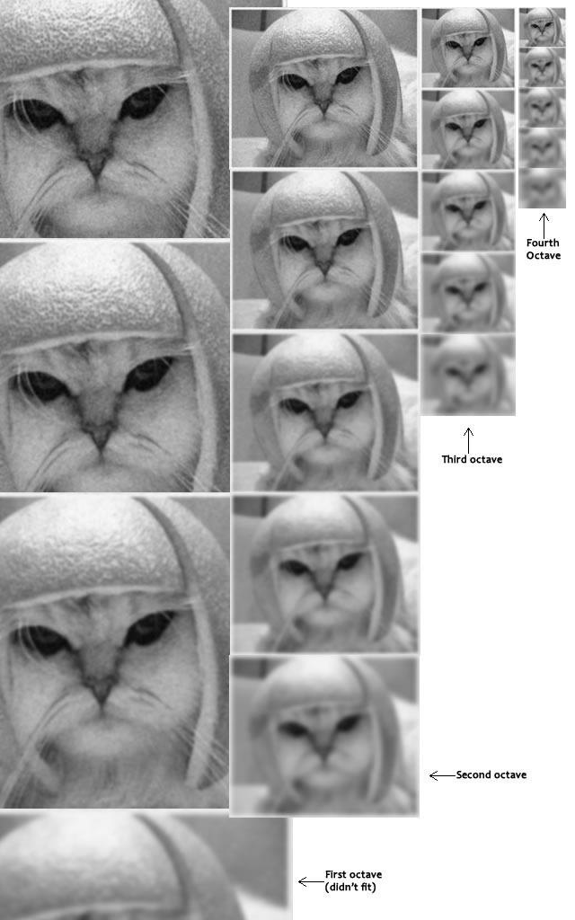
Features Descriptor(SIFT)
5 Scales(Blur Levels) and 4 octaves ideal for the algorithm
Gaussian Blur

Slide 19
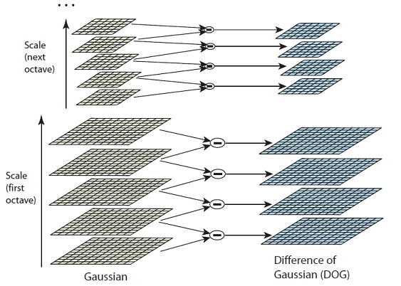
Features Descriptor(SIFT)
Difference between two consecutive Scales to generate DoG(Difference of Gaussian) Images

Slide 20
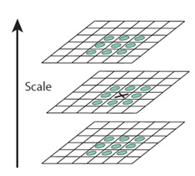
Features Descriptor(SIFT)
Locate maxima/minima in DoG images
X is marked as a "key point" if it is the greatest or least of all 26 neighbours

Slide 21
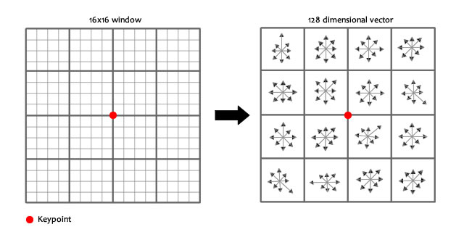
Features Descriptor(SIFT)
Creates a 16x16 window around the keypoint. This 16x16 window is broken into sixteen 4x4 windows.
Within each 4x4 window, calculates gradients and puts into 8 bin histogram.

Slide 22
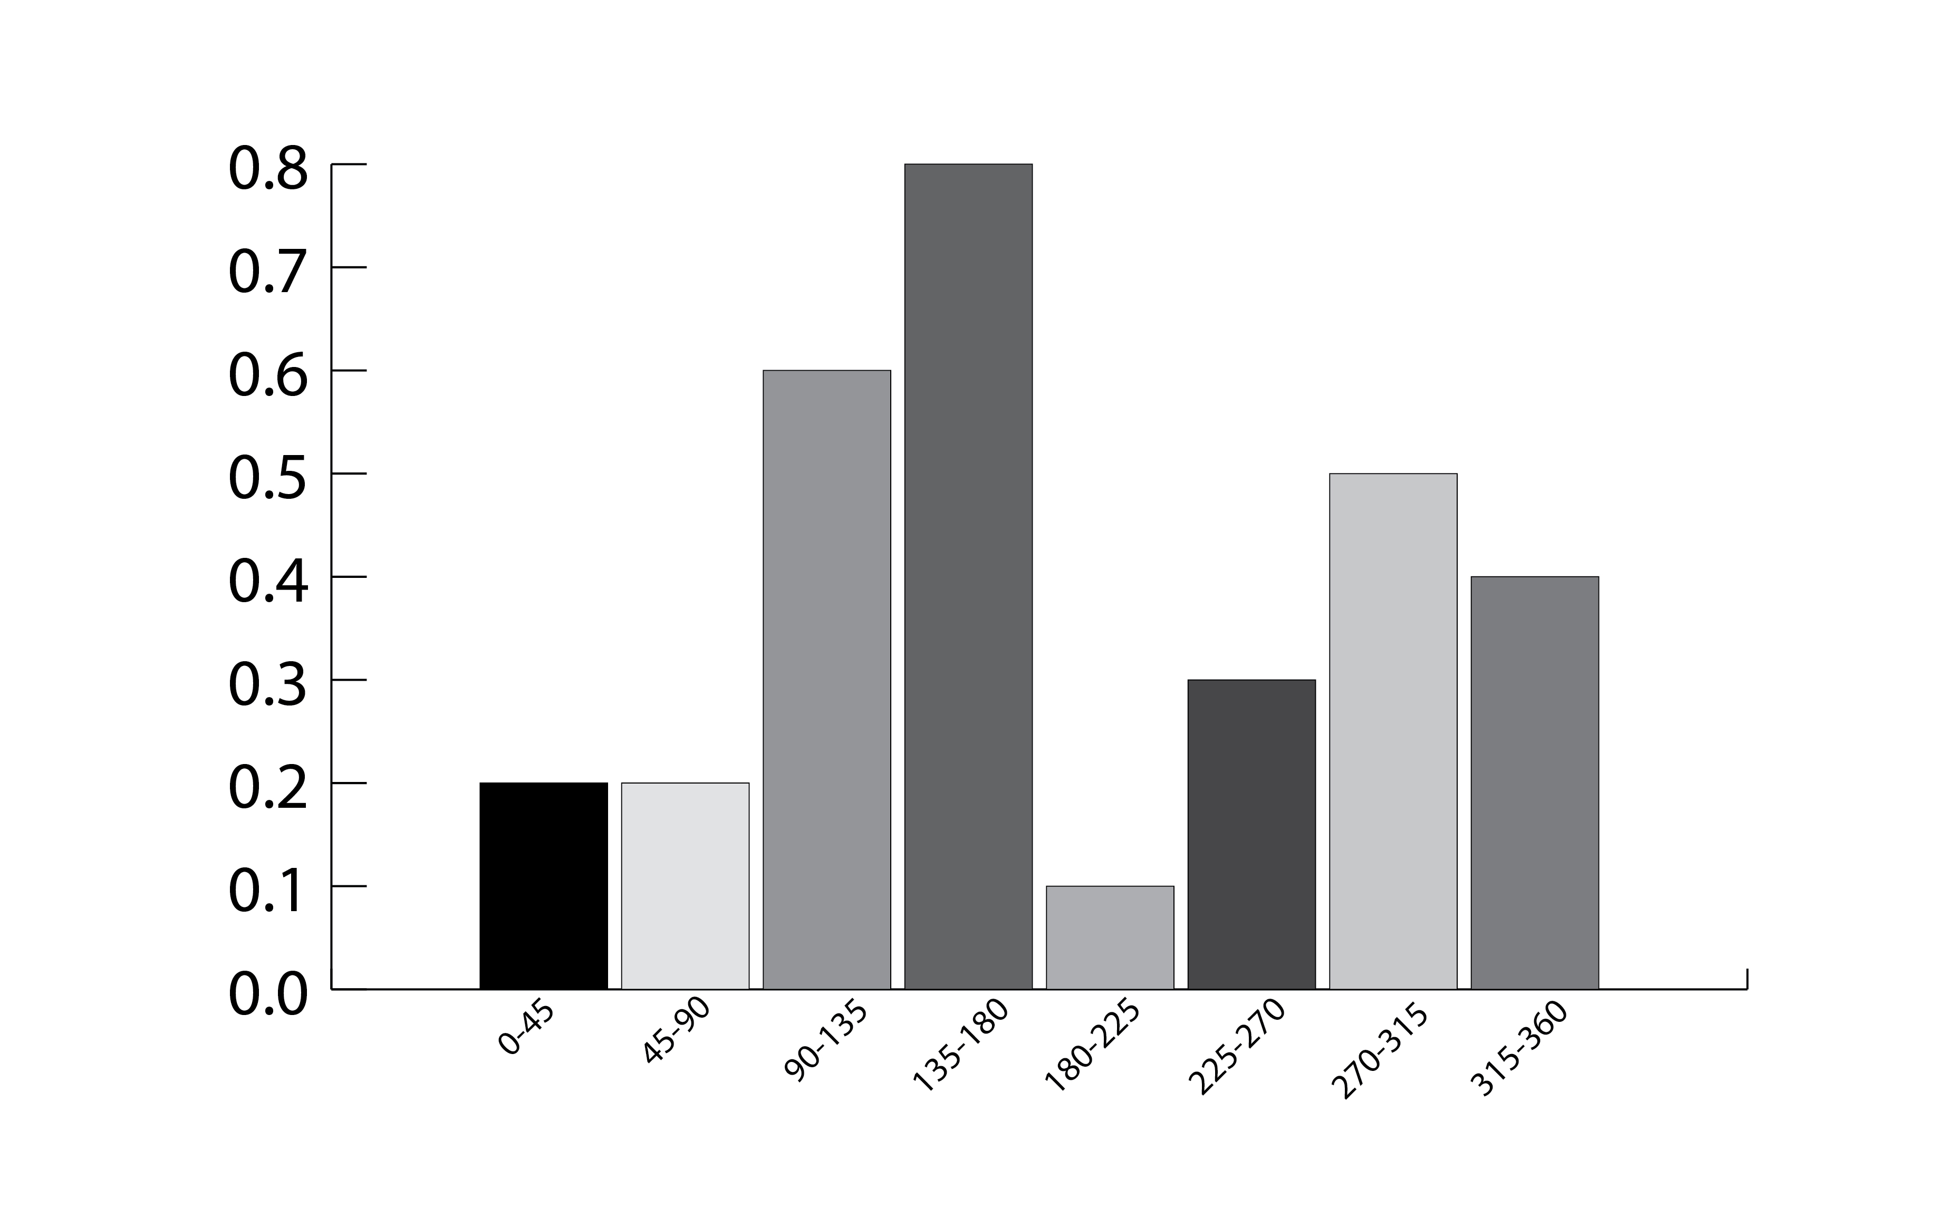
Features Descriptor(SIFT)
8 bin histogram for each 4*4 window
16x8=128 numbers to describe a keypoint(feature)
Thus each feature point is a 128 dimensional vector.

Slide 23
K-MEANS CLUSTERING
Suppose, Number of training images=200
Number of feature extracted from each image=100
Total number of feature points= 200,100.
Very large for computation
Use K-MEANS Clustering

Slide 24
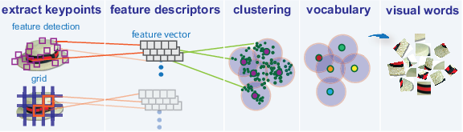
K-MEANS CLUSTERING
Unsupervised Machine Learning Algorithm
Creates Bag Of Words Model

Slide 25
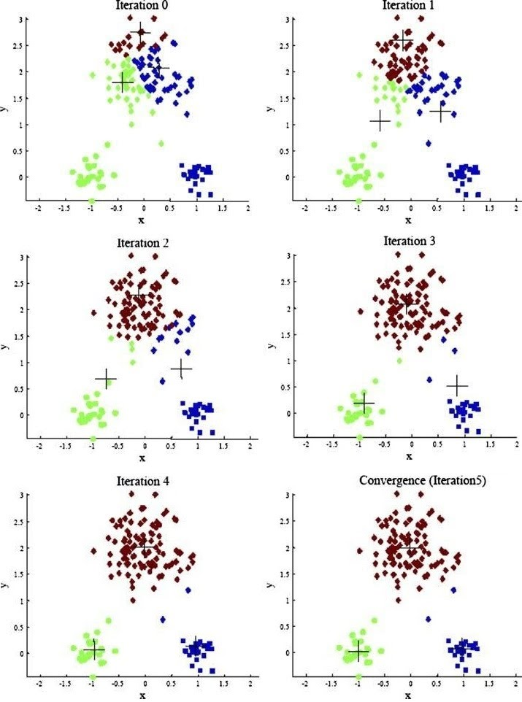
K-MEANS CLUSTERING
Here K=3
Initially randomly 3 cluster points are chosen.
In each iteration cluster center becomes more accurate
K=500 (for our purpose)

Slide 26
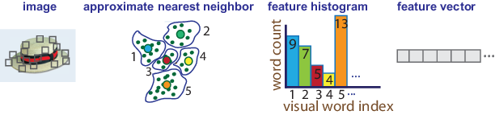
BAG OF VISUAL WORDS
Since K=500, Bag of Words created=500
One histogram for each training image using BoW model.
500 dimensional feature vector for each image
[9,7,5,4,13,……….]

Slide 27
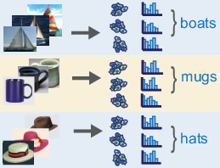
FEATURE HISTOGRAMS
Finally we have single histogram vector for each image of each class.
Histograms are normalized to make this process invariant to number of descriptors used .

Slide 28
SVM CLASSIFIER
-multiclass
-saab lai euta value
-one vs all classifier
-training model
-

Slide 29
SMO

Slide 30
LOCALIZATION
Image processing
Predict
display

Slide 31
REINFORCEMENT LEARNING
Ask user

